Slide 1
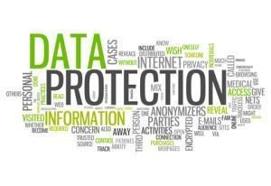
Data Protection for SDS Employers
Alison Johnston
Lead Policy Officer (Scotland)
Information Commissioner’s Office

Slide 2
The Strands of Data Protection Law
Data Protection
GDPR
Law Enforcement Directive
Data Protection Act 2018
E-Privacy
25th May 2018
6th May 2018
23rd May 2018
TBC

Slide 3
Key Definitions
Data Controller – the organisation that makes the decisions
Data Processor – an organisation instructed to process personal data on behalf of a Data Controller
Data Processing – anything which a Data Controller does with personal data, including storing it
Data Breach – anything that happens to personal data which shouldn’t
Data Subject – an individual identifiable from the personal data that you hold on them

Slide 4
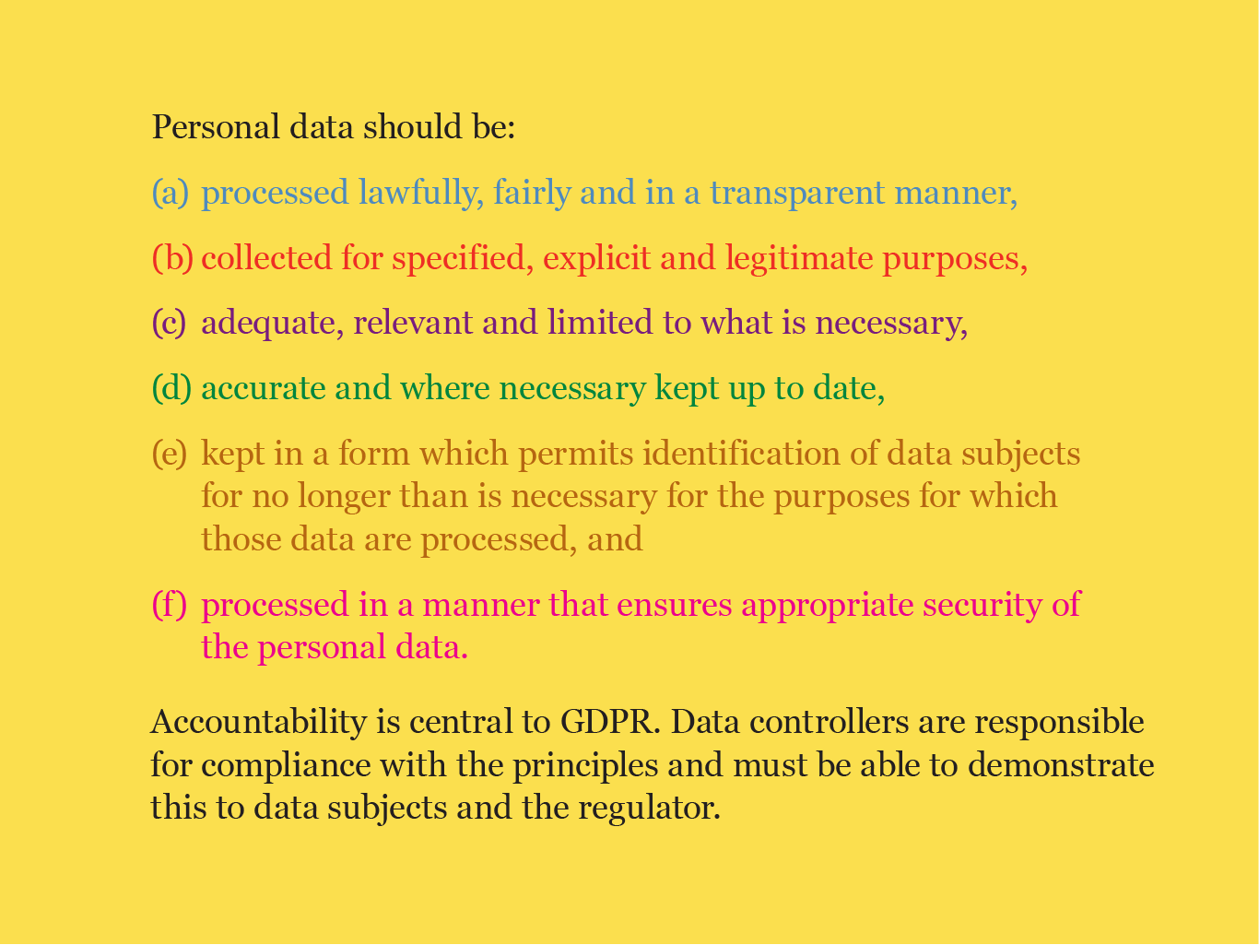

Slide 5
The Accountability Principle
The controller shall be responsible for, and be able to demonstrate compliance
Notes:
It is currently good practice to keep a record of your data processing as evidence of compliance. GDPR makes this a requirement.

Slide 6
What is Personal Data?

Slide 7
Personal Data is…
Any information relating, directly or indirectly, to an identified or identifiable natural person

Slide 8
Not all data is the same…
Race or ethnicity
Political opinions
Religious or philosophical beliefs
Trade union membership
Physical or mental health
Sexual life or orientation
Genetic or biometric
Notes:
The Data Protection Act has two types of personal data, normal personal data and sensitive personal data. Sensitive personal data is separated out from ordinary personal data as worthy of more consideration and security following conflicts in Europe.
Under GDPR sensitive personal data is referred to as special categories of data. Genetic and biometric data is added as a new class of special category data. Data about criminal convictions and offences is dealt with separately but still regarded as sensitive and to be used in limited circumstances.
There is one piece of information missing which most people assume would be classed as sensitive personal data and that is financial data. Although Financial data is not classed as sensitive personal data by the DPA or the GDPR the ICO treats a breach of this data as if it were sensitive data because of the impact a breach can have on an individual.

Slide 9

Personal Data isn’t Always Obvious!
Notes:
We need to be aware of what other information is out there that people can piece together to identify an individual. GDPR makes reference to this by stating that personal data is data which allows someone to be identified either directly or indirectly.
If you are using anonymisation or pseudonyms to protect an individual’s identity think carefully about how they are created. If they use initials or dates of birth then it’s possible people could identify an individual from them. For example, your driving licence number is made up of your name and date of birth. Likewise pseudonyms or locations may make an individual identifiable. It is about common sense and you have to consider what is reasonably likely in regards to the risk of individuals being identified.
Someone would have to want to identify a person and actively search out the additional information. The likelihood of this happening will depend on who you work with, with some people more likely to be at risk than others.
Some examples of data which can be used to identify individuals include locations, medication, the car you drive, work you’ve undertaken, in particular research work, even the name of your pet.

Slide 10


Recorded data
Electronic
Processed by automated equipment
Manual
Notes which will be automated
Filing systems
Official records
Public authorities
Notes:
The GDPR applies to the processing (which is anything you can thing of doing) of personal data wholly or partly by automated means and to the processing other than by automated means of personal data which form part of a filing system or are intended to form part of a filing system.
The new UK Data Protection Act will apply similar rules to health, education and social work records, as well as any other personal data held in manual form by a public authority.
MF

Slide 11
Who is responsible?
Data controllers
Data processors
Notes:
A data controller is “the natural or legal person, public authority, agency or other body which, alone or jointly with others, determines the purposes and means of the processing of personal data”.
Data processors are engaged by data controllers to process personal data but only on the controller’s instructions. They shouldn’t be making decisions.

Slide 12
I must get consent to process personal data under GDPR
FALSE
TRUE
FALSE
Consent is just one of the lawful basis for processing personal data

Slide 13
Conditions for processing
Personal data
Special category data
Consent
Contract with the individual
Comply with a legal obligation
Protecting vital interests
Public function in the public interest
Exercise of official authority
Legitimate interests of the data controller, but not prejudicial to the person
Explicit consent
Employment, social security, social protection law
Vital interests
Not for profit religious, political or trade union bodies
Put in public domain by the person
Legal proceedings/advice
Substantial public interest based on law
Health, medical, social care
Public health
Archiving, research, statistical
Additional conditions are in the new UK Data Protection Act 2018
Lawful Basis Tool
Notes:
In order to use personal data lawfully, you need to be able to rely on at least one condition for processing from the personal data column. If it is sensitive personal data, you need to be able to rely on at least one condition for processing from each column.
Other than consent, the conditions require that the processing is necessary. Consent has its own particular requirements.
All conditions have equal weighting: one does not carry any more status than any other. It is for the data controller to be satisfied that they are relying on the appropriate condition for each activity and document that in the record of processing activities. This is especially important when not relying on consent.

Slide 14
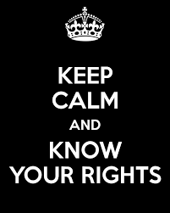
To be Informed
Access
Accuracy/ Rectification
Erasure
Restrict Processing
Object
Data Portability
Notes:
Fundamentally, the DPA is about establishing rights for individuals and placing obligations on organisations using personal data.
Individuals get all the rights: organisations have all the responsibility!!

Slide 15

Data Sharing

Slide 16
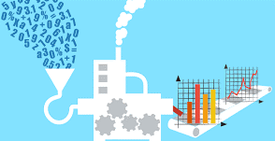
Data Processing

Slide 17

Data Breaches
Report to the ICO if it is likely to result in a risk to the rights and freedoms of individuals
Without undue delay;
No later than 72 hours.
Will need to provide specific details including: nature of data involved; contact point details; measures taken as a result of the breach
May need to notify individuals affected
Data Breach Guidance
Notes:
This is a new requirement and organisations must get good processes in place to ensure they are able to comply with the very short timescales. Remember, the ICO can fine an organisation for the breach but also for not reporting the breach – a double whammy!!
Some examples of action we have taken recently include…

Slide 18
Useful Links
Guide to the GDPR
ICO Resources and Support
Self Assessment Toolkit
ICO Guidance

Slide 19



Keep in touch
ICO Scotland
45 Melville Street
Edinburgh EH3 7HL
T: 0330 123 1115 E: Scotland@ico.org.uk
Subscribe to our e-newsletter at www.ico.org.uk
or find us on…
@iconews

