Slide 5
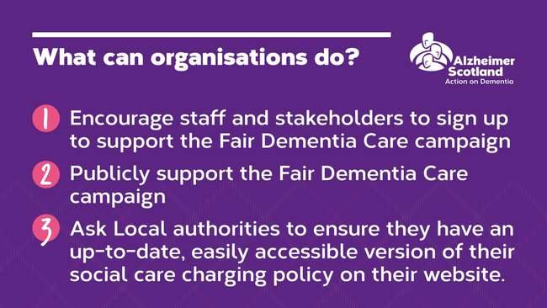

Slide 8
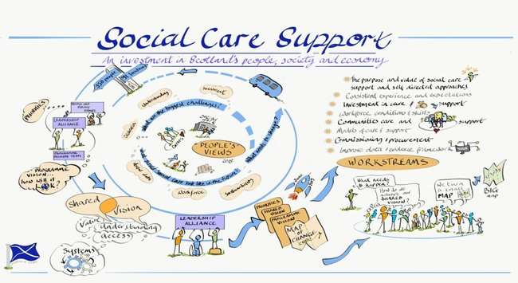

Slide 9
Social care support
An investment in Scotland’s people, society and economy
Lorna Ascroft
Programme Lead, Social Care Support
Scottish Government

Slide 10
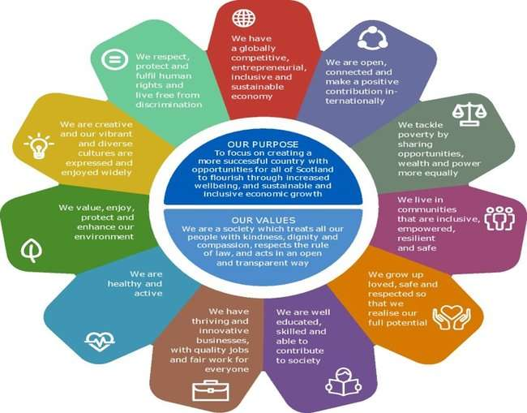
National Performance Framework

Slide 11
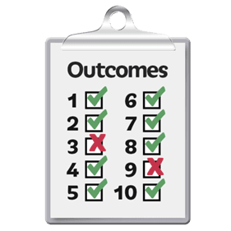
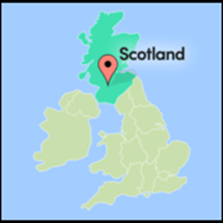
The framework sets out ‘national outcomes’ to help achieve its purpose.
These outcomes describe the kind of Scotland the framework wants to help us create.
The reform work will help with delivering some of those outcomes.

Slide 12
Outcomes that link to independent living, making social care a good career that people want to do and stay in, and the different options for care and support.
Our economy makes things better for people. It also helps protect the environment and the planet
The economy gets stronger with new ideas.It means we can compete with other countries around the world.

Slide 13
Outcomes that link to independent living, making social care a good career that people want to do and stay in, and the different options for care and support.
We have successful and creative businesses.
People living in Scotland have good jobs with fair working conditions.

Slide 14
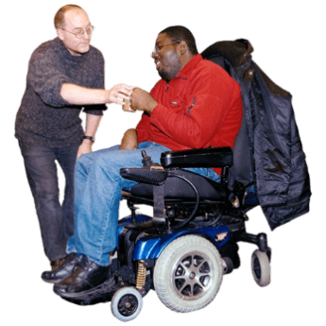
Outcomes that link to independent living, wellbeing and communities.
We are healthy and active.
We live in communities that include everyone, can make decisions, are strong and safe.

Slide 15
My Support, My Choice
Dr Dianne-Dominique Theakstone, SDSS
13th November | SDSS AGM

Slide 16
Project Overview
What is the ‘My Support My Choice’ project?
Survey (print and online)
Semi-structured interviews
Focus groups
Co-production (peer researchers)
SDSS and the ALLIANCE

Slide 17
Local Authority area
Wave 1:
Dumfries and Galloway
Scottish Borders
South Lanarkshire
North Lanarkshire
Highland
Stirling
Glasgow
Fife
Wave 2 (TBC):
Moray
Dundee
Edinburgh
Inverclyde
Aberdeenshire
Shetland

Slide 18
Focus Groups
People with learning disabilities
Women as users of SDS
Older people (65+)
LGBT people
BME people
Mental health
Rural communities
Visual impairments
Parent/guardian carers

Slide 19
Next Steps
Complete analysis
LA and thematic reports
LA feedback sessions and discussion
Wave 2 interviews and distribution
Can you help? If so, please get in touch!

Slide 20
Involvement
Survey: https://sdsscotland.formtitan.com/MSMC_survey
Local authority feedback sessions – please leave contact details if you’re interested in attending.
High response rates in areas where members have hosted drop in sessions, let us know if you would like to hold one!
Check Twitter (@SDSScot or @AllianceScot) and project partners’ websites for reports and publications.

Slide 21
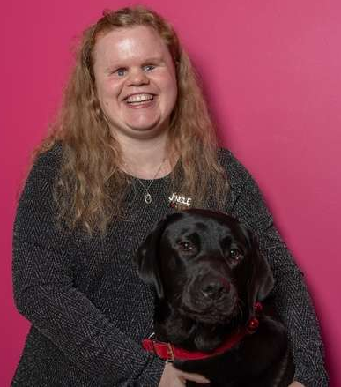
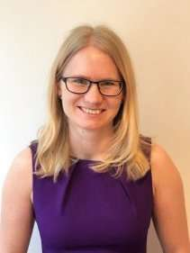
Contact Us
Dr Dianne Theakstone
Service Users’ Experience Research Officer
Self Directed Support Scotland
E: Dianne@sdsscotland.org.uk
T: 0131 475 2625
Hannah Tweed
Senior Policy Officer
Health and Social Care Alliance Scotland
E: Hannah.Tweed@alliance-scotland.org.uk
T: 0141 404 0231 (switchboard)

Slide 26
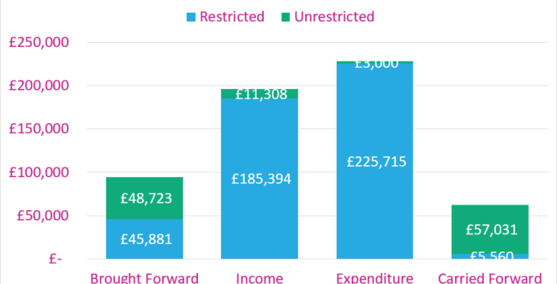

Slide 27
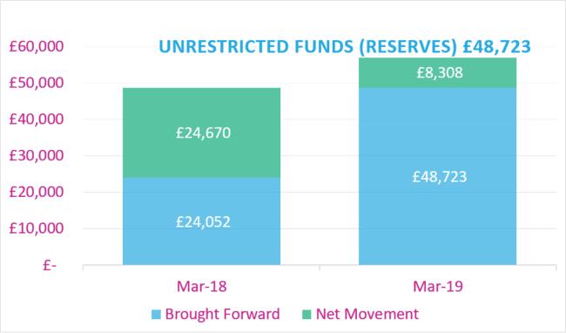

Slide 28
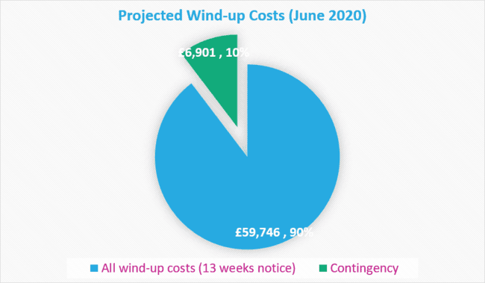

Slide 31
Independent Living Fund

Slide 32
1988 - Independent Living Fund opened for applications – max £815 week (Group 1 users)
1993 – Partnerships required to fund £340 – max ILF £475 week (Group 2 users)
2010 New Applications closed
2015 – UK ILF closed – Scotland - commenced

Slide 33
Approx. £50 million
Historically – Dept. for Social Security funded
Now – Scottish Government holds funds

Slide 34
User Numbers – Approx. 3000
Staff – 50
Drop off 5% approx. last year

Slide 35
Independent Living Fund
ILF – Senior Management Team report to the Scottish Government Sponsor Team
And our stakeholder group chaired by a recipient.
And our ILF Board

Slide 36
Assessors allocated reviews
Visits arranged with Social Worker and ILF users
Care Schedule sent to Social Work
Review completed
New award agreed

Slide 37
Important Issues
Partnerships need to maintain package funding
Care Schedules are completed and brought to review
Changes in circumstances are reported

Slide 38
Eligibility Issues/Dangers
Partnerships must usually contribute more than ILF
ILF cant be regarded as a fixed part of an SDS package

Slide 39
HSCP Social Work Role
Attend review
Update ILF Assessor with changes in circumstances
S.D.S. Plan would be great
Outcomes focussed shared care plan

Slide 41
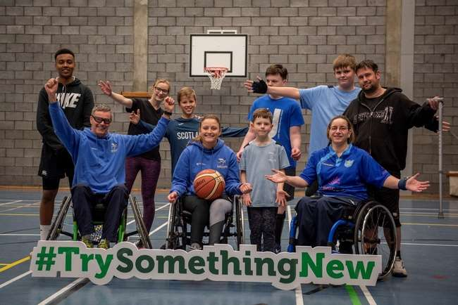
ILF Scotland Transition Fund

Slide 42
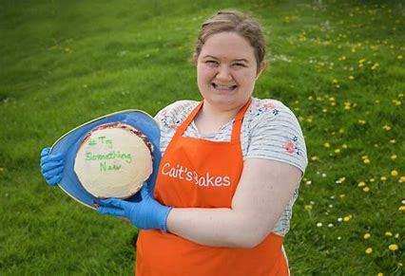
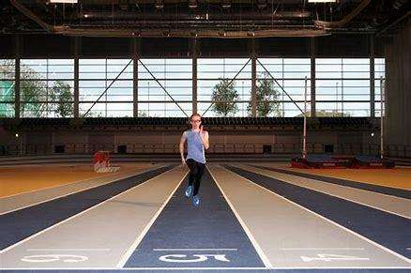
What is the Transition Fund?
The ILF Scotland Transition Fund provides money, for up to one year, to support young disabled people aged 16-21, who are at a transitional stage in their lives.
The Fund helps young disabled people access opportunities that enable them to participate in their communities.

Slide 43
Who can apply?
You can apply for the ILF Scotland Transition Fund if you:
Are between the age of 15 and 25 years old;
Have lived in Scotland for the last 6 months;
Have an impairment or disability (as defined in the Equality Act 2010);
Have less than £26,250 of personal savings.
Although the Fund is not exclusive to people who receive little or no formal social work support, they will be prioritised.

Slide 44
Impairment or disability (as defined in the Equality Act 2010).
You might be eligible for the Transition Fund if:
you have a learning difficulty, dyslexia, dyspraxia or autism.
You have a physical or mental impairment
The impairment has a considerable and long-term adverse effect on your ability to carry out normal day-to-day activities

Slide 45
An impairment doesn’t have to be a diagnosed medical condition:
You may be suffering from stress or you might have mental impairments - like difficulty concentrating - as well as physical impairments such as extreme tiredness and difficulty sleeping
An impairment doesn’t have to stop you doing anything, but may make day-to-day tasks more difficult. It might cause you pain, things may take much longer than they should or you might be unable to do an activity more than once
https://www.citizensadvice.org.uk/law-and-courts/discrimination/protected-characteristics/what-counts-as-disability

Slide 46
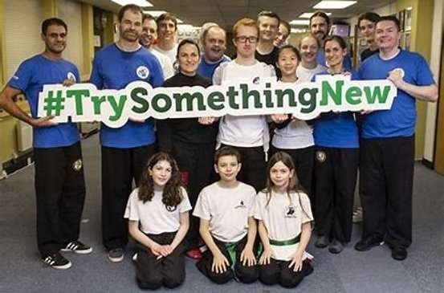
#TrySomethingNew
You can use the money for things like:
art or music lessons or sports coaching
a device or piece of technology to help you in your transition
travel training,
to join a class and/or club,
driving lessons,
training courses.

Slide 47
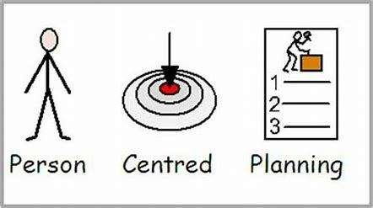
Young Person’s Planning Grant
Not sure what to apply for but want to be part of your community and spend time with other people?
ILF Scotland can provide person centred planning grants to help young people find the support they need
to plan their future and
make and application
to the Transition Fund.

Slide 48
Limits on using the money
Money from the ILF Transition Fund cannot be solely used for these things:
Anything that should be provided by another organisation (Social Work, SAAS, NHS etc)
Personal care
Medical care
Cleaning and domestic duties
Supervision
Essential safeguarding/adult support and protection.

Slide 49
Transition Fund is a resource for young people 1. Make it a real option at key planning points in their lives 2. Embed it into the transition agenda 3. Consider it alongside other resources

Slide 50
Contact us
Facebook/IndependenLivingFundScotland
@ILFScotland
#TrySomethingNew
Enquiries@ILF.scot

Slide 51
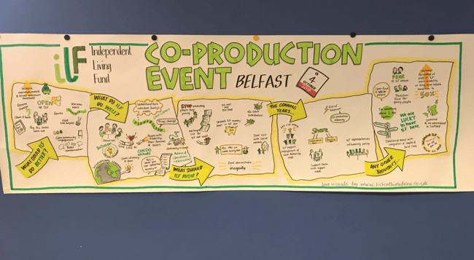
ILF Scotland: the future?

Slide 52
The 3 stage Consultation Process
8 Co-production events throughout Scotland and Northern Ireland
20 interviews held with representatives of stakeholder organisations
66 responses to an Online survey

Slide 53
The Consultation Questions (slightly adapted for each audience – No Question 5 for NI Groups)
1. What does ILF Scotland do really well in enabling independent living for disabled people in Scotland and Northern Ireland (and should do more of?)
2. What could ILF Scotland do even better in terms of making independent living a reality for disabled people in Scotland and Northern Ireland?
3. Is there anything ILF Scotland currently does that it should not do going forward?
4. The Scottish and Northern Ireland Governments are reforming adult social care. To that end what role do you think ILF Scotland could play in supporting independent living for disabled people in the coming years?
5. (Scotland only) ILF Scotland and the Scottish Government are thinking about how more disabled people can access the Transition Fund. What do you think our priorities should be?
6. Any other comments of thoughts not covered by previous questions that ILF should consider when putting together its strategy for the next 3 years?

Slide 54
Stakeholder Interviews
BTA held 20 telephone or face to face interviews with people from stakeholder organisations, held between August and October.
The interviewees were:
Dr Sally Witcher, CE, Inclusion Dr Jim Elder-Woodward, Chair SILC
Florence Garabedian, CE, Lothian CIL Etienne d'Aboville, CE, Glasgow CIL
John Wood and Claire Thomas, COSLA James Fletcher, CEO, ARC
Sam Smith C-Change Tressa Burke, Glasgow Disability Alliance
Gillian Edwards, Perth and Kinross CIL Lesley Thomson, Scottish Government
Colin Dunlop, Sponsor Team NI Jenny Miller, PAMIS
David McDonald, Chair Stakeholder Group NI
Bryan Myles, CE, Centre for Independent Living NI
Jack Blaik and Elaine Black, Scottish Government
Prof Nick Watson, Chair of Disability Studies, Glasgow University
Charlie McMillan, CE, Scottish Commission for Learning Disability
Margaret Petherbridge, Chair, Social Work Scotland
Dr Jane Kellock, Head of Strategy & Development, Social Work Scotland

Slide 55
Online Consultation Survey
The survey was posted on the ILF website and widely promoted by disabled people’s organisations
The survey was anonymous and was completed by 66 people
It was clear from the responses that there was a wide variety of respondents; from people with considerable knowledge of the Fund, to people with no knowledge of the Fund
Responses were broadly similar to those gathered at the Co-production events and the Stakeholder interviews - there were consistent themes throughout all three consultation processes

Slide 56
Co-production Events
There have been 7 of these to date - Dumfries, Dundee, Inverness, Glasgow, Edinburgh, Derry and Belfast. An 8th event will be held in the Scottish Borders
The events were managed by the ILF staff team and presented by Peter and Harvey
The events were attended by over 200 participants including people in receipt of ILF funding, their families and carers, care professionals and ILF staff in support
Events followed an inclusive format using roundtable facilitated discussions, recording of all comments and an illustrator to capture the overall themes

Slide 57
Key Themes
The most common feedback, from all participants, across all of the consultation processes, was that there is a very positive view of the work of ILF
The process is efficient and accessible. Some people commented that they would like to see bureaucracy reduced further, but there was substantial praise for the process, especially when compared with other funding streams
ILF staff are held in high regard by both those who access the Fund and by fellow professionals
People want the Fund re-opened (both in Scotland and in Northern Ireland)
The Transition Fund is seen as having made a positive early start, but people want to see it extended
There is some confusion amongst recipients about where ILF start and local authorities stop
Charging should be taken away

Slide 58
Brass Tacks
Close ILF: redistribute fund to Local Authorities as has happened in England
Allow ILF to gradually reduce and close.
Extend ILF funds.
Entirely new usage? This is up to you. We will deliver what the Scottish Government advises us to deliver.

