Slide 1


Welcome from SDS Team Social Work Scotland
Standard 12
Budget and Finance Standard development

Slide 2
SDS STANDARDS
SDS STANDARDS DEVELOPMENT LEARNING REVIEW
Published Scottish Government Website

Slide 3

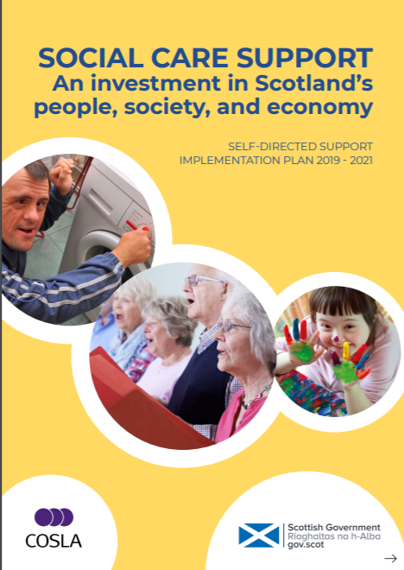

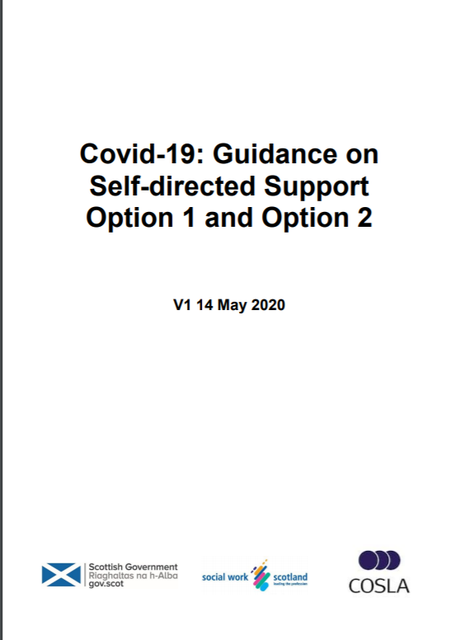


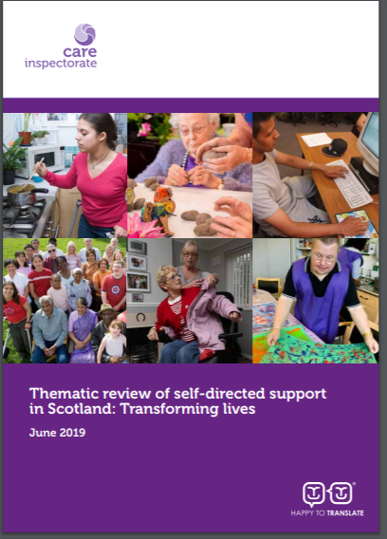
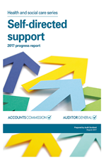
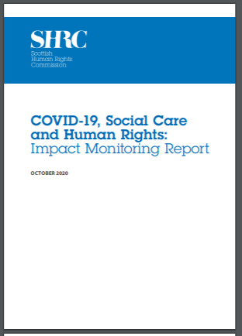

Slide 4
The 11 standards already developed advocate the following:
Access to independent support and Advocacy
Early support and help
The identification of people’s own capabilities and natural support networks. How community, other support and technologies can support an individual
Smooth transitions
Transparent recording of choices and decisions made on a person’s support plan
People being able to challenge decisions made on their support plan
Risk enablement and not risk aversion
That Commissioning models are in line with SDS

Slide 5

This 12th standard aims to point towards a greater degree of consistency and a fair and equitable system for workers to access and spend budgets in line with people’s agreed personal outcomes. So that when a person moves from one local authority to another, the same outcomes are honoured.
Will be co-produced with identified subject matter experts (National Partners) including CIPFA, COSLA, SG, ILF, DWP and SSS.
sds.team@socialworkscotland.org

