Slide 1
Personal Assistants Training Framework
PA Programme Board: 27.1.22

Slide 2
What matters
Centrality of PA and PA Employer relationship promoted through training
PAs have parity of access to training opportunities as available to wider social care workforce
PAs have parity of access to career opportunities as available to wider social care workforce
PAs have access to peer support/informal networks
Social Workers and wider social care workforce have confidence and knowledge around supporting people to use option 1 to employ PAs

Slide 3
Provide training and support that maximises strong mutual relationships between PAs and Employers

Slide 4
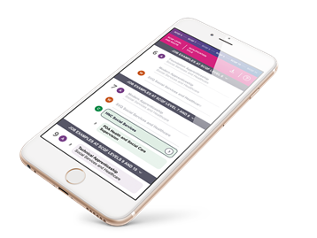
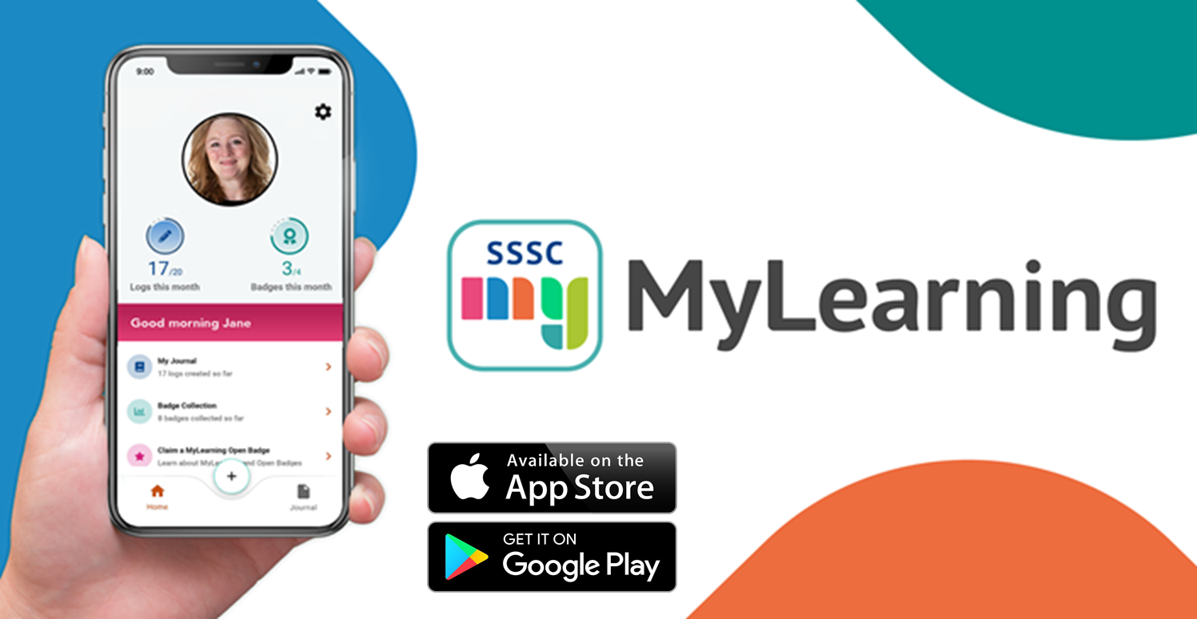
Training and Career opportunities available for social care workforce
Pre employment programmes
National Induction Framework
Career / Qualification pathways
Open access Learning Resources
(SSSC Learning Zone, SDS Library, Personal Outcomes Network, PA Outcomes map)
www.mylearning.scot
Open Badges
Relevant for PAs?
Clearly signposted?
Easily Accessible?

Slide 5
Things to pay attention to
Gap analysis
Evidence of learning gained – portability, validation
Requirement to learn or to provide learning
Accessibility, where is best ‘go to’ place for PAs
Framework of knowledge and skills or Framework of learning support
Resources / Conditions to support learning: Funding, time, digital capacity, collaboration, DP agreement
Short-life working group??

