Slide 1
Ethical Commissioning
What is it and where does it connect with SDS?
SDSS conference workshop 22nd March 2023
Notes:
Add SG logo

Slide 2
Welcome!
Louise Bowen, Development Lead, Iriss
louise.bowen@iriss.org.uk
David Kerr, Team Leader
Adult Social Care Workforce and Fairwork Division, Scottish Government
David.Kerr2@gov.scot

Slide 3
Workshop plan
Intros and icebreaker
What is ethical commissioning?
Conversations
Resources and further reading
Closing reflections
Hello and welcome

Slide 4
Please mute your mic
Camera on or off - your choice!
Use the chat for comments and connecting with people!
Raise hand for conversations, asking questions
Please say who you are when you start talking
Mixed group today - different experiences and knowledge base about SDS and commissioning!

Slide 5
Icebreaker
In the chat - in one word (or a sentence!)
What do the words ‘ethical commissioning’ mean to you?

Slide 6
What is ethical commissioning?

Slide 7
Background
IRASC
The Independent Review of Adult Social Care (IRASC) recommended the establishment of a National Care Service (NCS).
On 19 December 2022, the Scottish Government and COSLA issued an updated joint statement of intent outlining how they will continue to work together to deliver key commitments in response to the Independent Review of Adult Social Care in Scotland.
Adult Social Care

Slide 8
Ethical Commissioning
The Scottish Government and COSLA have jointly committed to the IRASC recommendation to develop and agree shared ethical commissioning principles and establish core requirements for ethical commissioning
We expect the draft ethical standards to include:
person-centred care first
human rights approach
full involvement of people with lived experiences
fair working practices
high quality care
climate and circular economy
financial transparency, sustainable pricing and commercial viability
shared accountability

Slide 9
The Adult Social Care Ethical Commissioning Working Group
Develop a framework for ethical commissioning
Complement the activities in respect of wider fair work principles
Consider areas of existing good practice, barriers and opportunities to change commissioning practice now and in the future
Working with CCPS: commissioning for outcomes and supporting good practice in the sector

Slide 10
Ethical Commissioning and the National Care Service
Ethical commissioning and ethical procurement will be used to shape all commissioning and procurement decision making.
A cornerstone that the National Care Service will use to shape all commissioning and procurement decision making
We will work with our key stakeholders to develop a framework for ethical commissioning and procurement
Our approach to ethical commissioning and procurement will be designed with partners, the providers and representative users

Slide 11
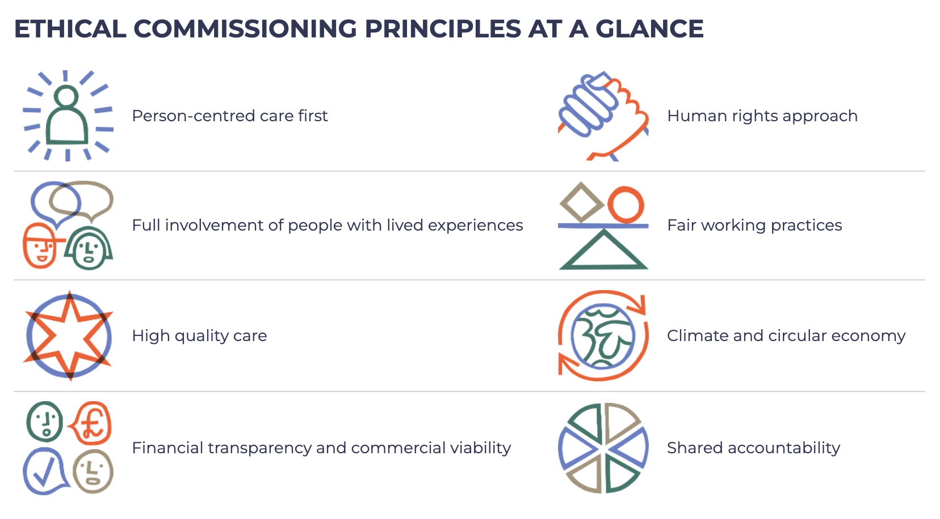

Slide 12
SDS and ethical commissioning
Collaboration and participation between all stakeholders to plan, purchase, create and provide support
Focus on achieving the outcomes that matter to people
Relationships at the heart of social care and support.
Enable choice, personalisation and independent living
Sustainable support
Not waiting for a National Care Service but using what’s available now - resources, people power, existing legislation and flexibilities
SDS Standards are there already!

Slide 13
Commissioners and support providers told Iriss…
Ethical commissioning should enable
Investment in relationships
Safe, honest and respectful partnerships
Affordability and fair work
What people really need as the starting point
Building a shared approach or ethos
Use of the existing flexibilities in procurement guidance/ legislation

Slide 14
Commissioners and support providers told Iriss…
Acknowledge that no one solution fits all (we need local solutions)
It’s not about ‘doing more with less’
Not everything can be solved by commissioning alone
Be brave to try something new
Identify ways to break down barriers
Find the time and people resources to do things differently
Build on good relationships and ways of working, keep investing in these

Slide 15
Conversations
In your setting, how could ethical commissioning help to achieve the aims of SDS implementation?

Slide 16
Ethical commissioning resources

Slide 17
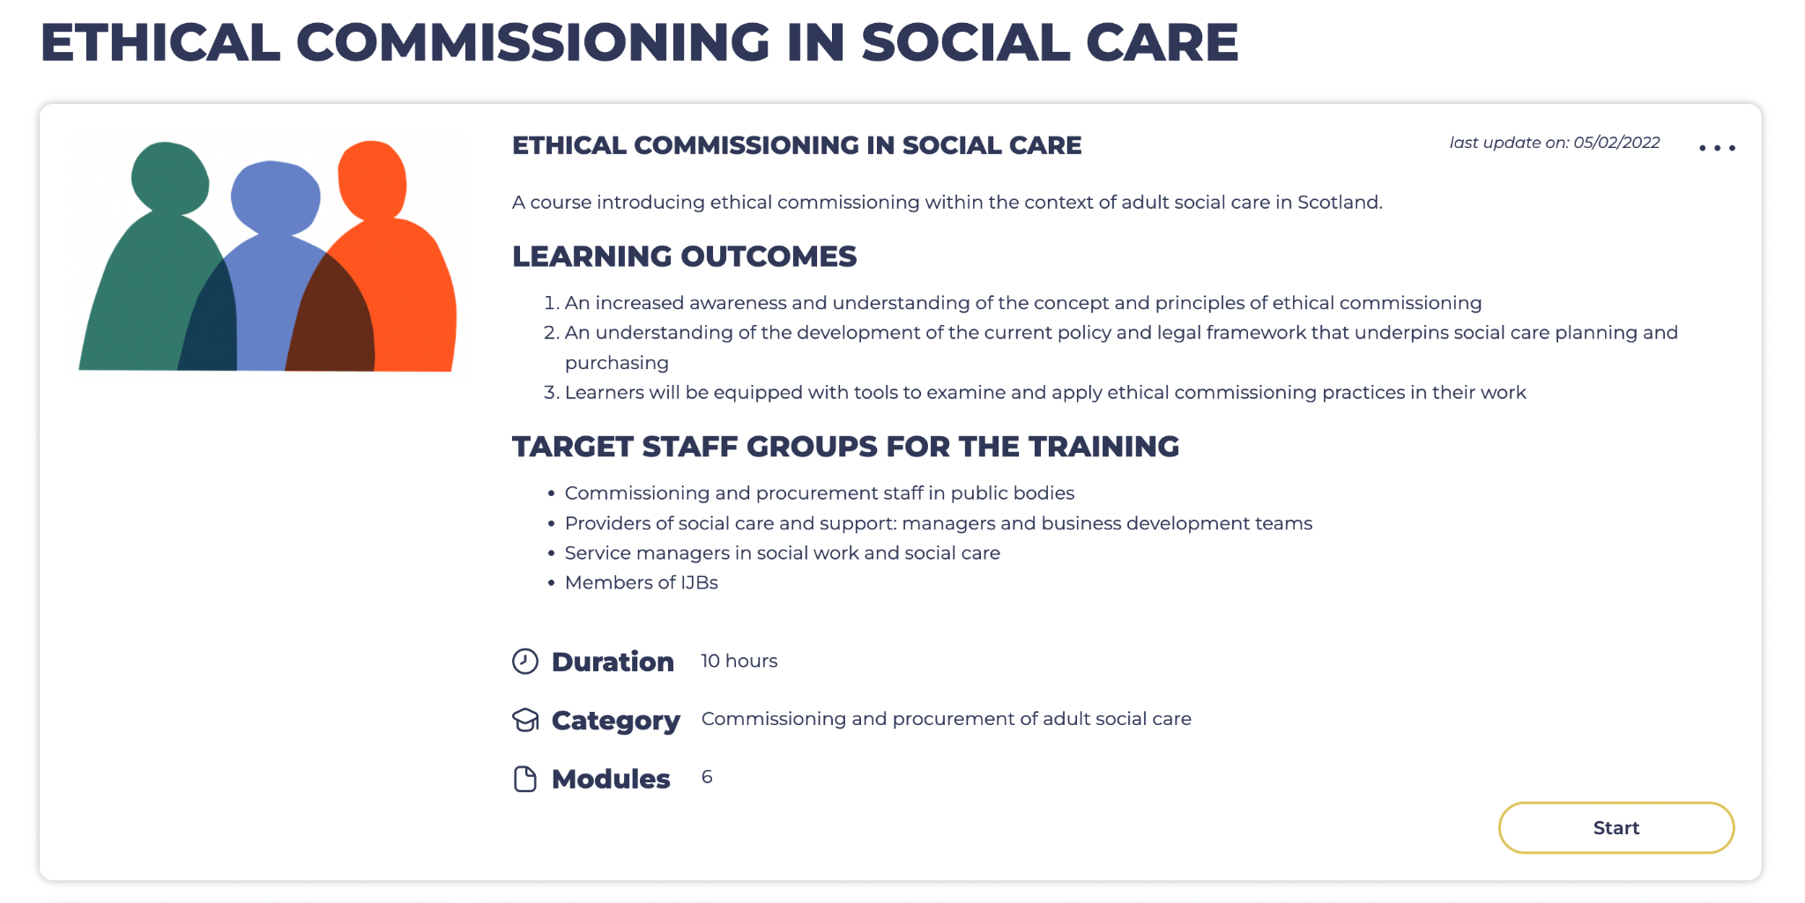
Ethical commissioning resources
Iriss online learning
Free
Self paced
Perspectives from real life practice
Introduces policy and practice, EC principles
Tools for exploring ethical commissioning with your team or partnerships
Email Louise if you have any questions
https://www.iriss.org.uk/resources/online-learning-materials/ethical-commissioning-social-care

Slide 18
More ethical commissioning resources
CCPS: Commissioning for Outcomes
https://www.ccpscotland.org/our-work/cp-commissioning-for-outcomes/
Practical guidance on outcomes based commissioning with links SDS Framework of Standards and Health and Social Care Standards. Includes a template for outcomes based Option 2 contract and links to other resources.
Good practice in procurement
https://www.ccpscotland.org/our-work/good-practice-in-procurement/
Links to Myth Buster resource for procurement in social care
Work in progress in NHS Highland to reshape Option 2 (with In Control Scotland)
https://www.iriss.org.uk/news/feature-articles/2023/01/24/no-one-direction-commissioning-differently
Scottish Government: Scottish Public Procurement Notice 7/2021
Scottish Public Procurement Notice 3/2022

Slide 19
Thank you for joining us today!
Please get in touch to follow up on anything
David.Kerr2@gov.scot louise.bowen@iriss.org.uk

