Slide 1
Training Framework Resources
Anne-Marie Monaghan
Zoe McIntyre

Slide 2
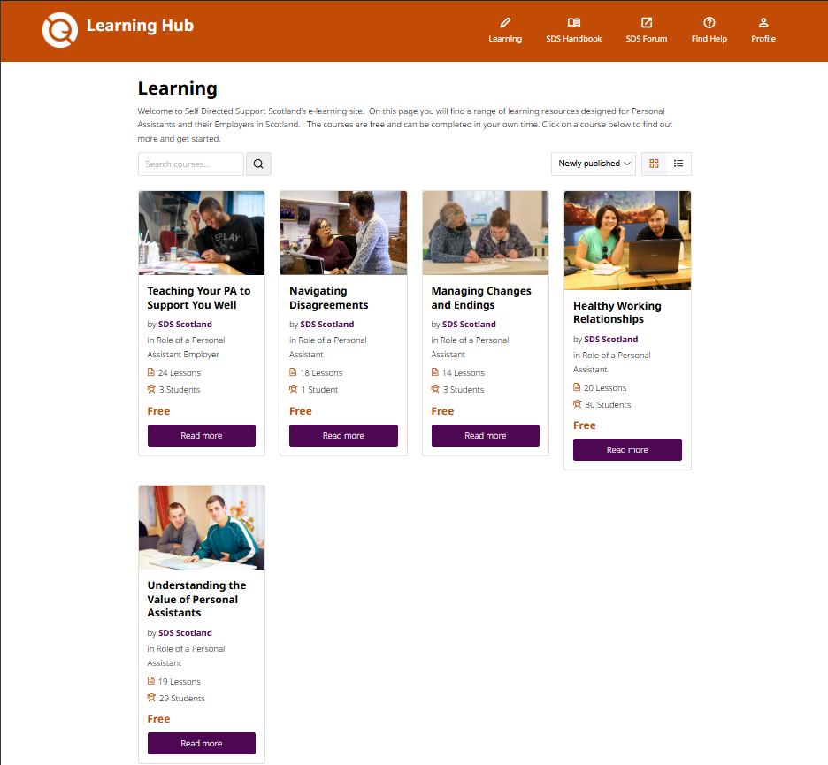
PA Employer and PA resources: Learning hub
Topics covered
Understanding the Value of Personal Assistants
Navigating Disagreements
Managing Changes and Endings
Healthy Working Relationships
Teaching Your PA to Support You Well
… and more to come!
Learning.handbook.scot

Slide 3
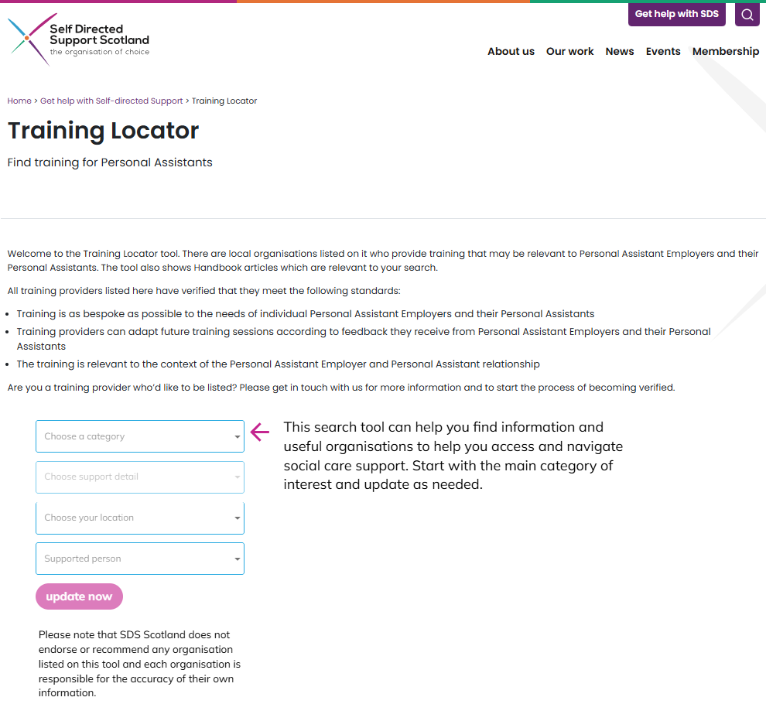
PA Employer and PA resources: Training Locator
Opportunity to find/promote the following training:
Role of a PA
Disability Equality
Autism
First Aid
Moving and Assisting
... And more topics to be listed soon!
www.sdsscotland.org.uk/get-help-with-sds/training-locator/

Slide 4
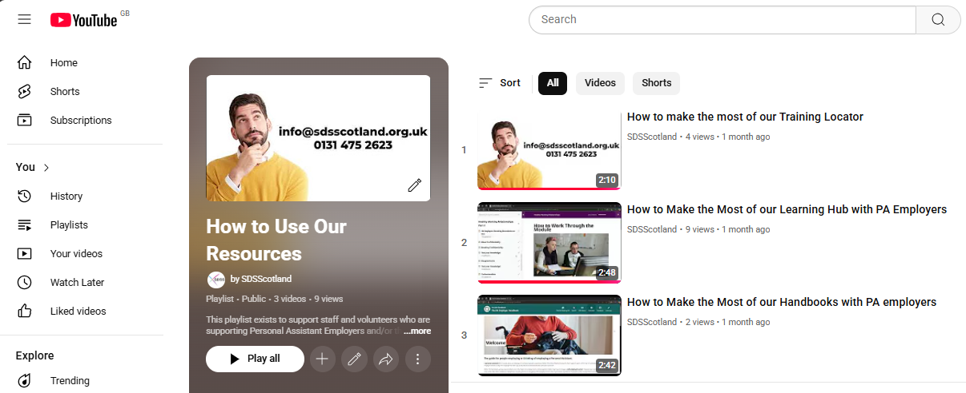
Video guides
YouTube: @SDSScotland

