Slide 1


SDS National Voice 2026:
Learning and Leading
Joanna Macdonald
Chief Executive, National Social Work Agency, and
National Chief Social Work Adviser

Slide 2

The National Social Work Agency
The National Social Work Agency is Scotland’s national leader for social work excellence – it is progressive, collaborative and people-focused.
By combining expertise and knowledge with practical support, the National Social Work Agency aims to empower social workers and partners to deliver equitable, high-quality care for all.
We are responsible for leading excellence and driving positive change across the social work profession in Scotland, and for providing expert impartial social work advice to Scottish Government policy teams.
National Social Work Agency is:
an executive agency of the Scottish Government
led by Joanna Macdonald, as National Chief Social Work Adviser and Chief Executive
a principal partner in the Scottish Social Work Partnership, with COSLA and Social Work Scotland
Leading excellence, driving change

Slide 3
Vision, mission and values
Our vision
The National Social Work Agency will empower Scotland’s social work profession to champion social justice, protect rights and keep people safe across Scotland.
Our mission
We will work in partnership with the social work profession, people with lived experience, and partners to strengthen practice, elevate the profession, shape policy, and drive positive change.
Our values
leadership
collaboration
excellence
equity
Our strategic objectives
drive national leadership
provide impartial social work advice across government
promote continuous improvement in design and delivery of social worker education and learning
plan for a future workforce
strengthen improvement and implementation
foster excellence in our organisation
Leading excellence, driving change
Notes:
Scotland’s National Outcomes collectively describe the Scotland we want to create.
As a public body, the National Social Work Agency must consider the National Outcomes in its work, including the ambition that:
we grow up loved, safe and respected so that we can realise our full potential
we live in communities that are inclusive, empowered, resilient and safe
we are well educated, skilled and able to contribute to society
we have thriving and innovative businesses with quality jobs and fair work for everyone
we respect, protect and fulfil human rights and live free from discrimination
we tackle poverty by sharing opportunities, wealth and power more equally

Slide 4
Remit and responsibilities
Provide national leadership, coordination, and support for the social work profession in Scotland, and will:
advocate for all social workers, including students
provide professional, impartial social work advice to Scottish Ministers
contribute to national policy affecting social work
support the National Chief Social Work Adviser to provide national professional leadership
hold policy responsibility and oversight of social work education and professional learning
oversee improvement priorities and promote collaboration with improvement agencies in the sector
report annually on Scotland’s social work services and workforce
work with partners, through the Scottish Social Work Partnership (SSWP), to have oversight of national workforce planning and workforce numbers
enable collaboration and delivery of the Scottish Social Work Partnership’s Strategic Plan for Social Work in Scotland (2026–29)
Leading excellence, driving change
Notes:
Feb 2025: Cabinet decision to establish the NSWA based on evidence, business case (developed with the sector) and sector sustainability
June 2025: Care Reform (Scotland) Act 2025 amends the Social Work (Scotland) Act 1968:
states the Scottish Ministers must designate a member of their staff as the National Chief Social Work Adviser
this person must be a registered social worker
The National Chief Social Work Adviser has statutory duties:
advising Scottish Ministers on policy relating to social work and the protection of individuals at particular risk of harm
preparing an annual report for Scottish Ministers on the state of social work services and the social work workforce in Scotland
The National Chief Social Work Adviser will also be Chief Executive of the NSWA and accountable to Scottish Ministers for the quality of NSWA work.

Slide 5
Difference the NSWA will make …
Statutory authority and impartial expertise: provide independent evidence-based professional advice to Ministers, ‘on policy in relation to social work and the protection of individuals at particular risk of harm’
Championing social work in government: act as an authoritative voice for social work, advocating its
critical role in health and social care, and in improving outcomes for people
Consistency in national policy and practice: develop national frameworks that reduce variability,
promote best practice, and enhance public confidence in social work
Proactive policy and legislative input: engage early in policy development to assess proposals for their impact on human rights, equity, and social justice, preventing unintended consequences
Driving effective implementation: monitor and influence the rollout of national strategies so they reflect the realities of social work practice and deliver meaningful improvements for people
Future-proofing the profession: lead on workforce development through a National Training Plan, ensuring consistent standards, continuous professional development, and readiness for emerging challenges
Transparency and accountability: publish an annual report to Scottish Ministers highlighting issues,
progress and recommendations for strengthening social work’s contribution to national priorities
Leading excellence, driving change

Slide 6
National Social Work Agency role in supporting SDS
Consistency of messaging and visible backing for ethical decision-making are key to sustaining trust - The Agency will support strong national leadership, aiding local partners to provide clarity of intent and reinforcing that values-based, human‑rights based, person‑led social work practice is supported.
A national advocate of values, conditions and standards - that enable social work to function as intended, to anchor SDS firmly in rights, relationships and professional judgement.
We have a commitment to be highly visible and meet and hear from people – this includes close working with the SDS Collaboration going forward, to ensure our actions are informed by those with lived experience
The National Social Work Agency national role in workforce planning, education, professional development and service improvement - empowering the profession and working in partnership to drive positive change and support safe, flexible and relational practice around SDS.
Leading excellence, driving change

Slide 7
Governance and planning
Framework agreement with Scottish Ministers will outline the National Social Work Agency roles and responsibilities, budget, accountability and governance as an executive agency of the Scottish Government.
We will publish a 1-year interim corporate plan for 2026–27
A suite of governance documents will coincide with launch on 17 March 2026 (World Social Work Day)
Reporting via annual report and National Chief Social Work Adviser annual state-of-social-work report
Our corporate plan will outline our vision and values, who we are, how we will work, our strategic objectives and our aims. It will align with the current direction of the Scottish Social Work Partnership.
Our website will hold our corporate documents, as well as reports required of an executive agency and the statutory reporting of the National Chief Social Work Adviser. Our visual identity will appear with Scottish Government branding.
OCSWA will cease to exist on the launch
of the National Social Work Agency
Leading excellence, driving change

Slide 8


Scotland has a skilled, supported and sustainable social work workforce; one that upholds human rights, promotes social justice, and discharges statutory duties on behalf of local government; and to harness evidence-informed practice, promote social work principles and reinforce the value of social work in all systems in which it operates.
Creating the Scottish Social Work Partnership
Notes:
NSWA, COSLA and Social Work Scotland, through the SSWP will provide unified leadership, align priorities and drive sustainable improvement across the workforce.
Approach has political endorsement from national (Scottish Ministers) and local (COSLA Leaders) government – they will jointly agree a national strategic plan for social work.
It will be the responsibility of the three principal partners to deliver the intentions in the strategic plan.
NSWA will closely align with the SSWP, ensuring that national priorities are informed by the experience of those in local social work services.
Each partner will lead on a different priority theme:
COSLA = workforce planning
NSWA = education and learning
SWS = professional governance and leadership
Aim of the SSWP (on slide)
Operating in ‘shadow-form’ since May 2025 to establish / formalise ways of working across three principal partners, incl governance.

Slide 9
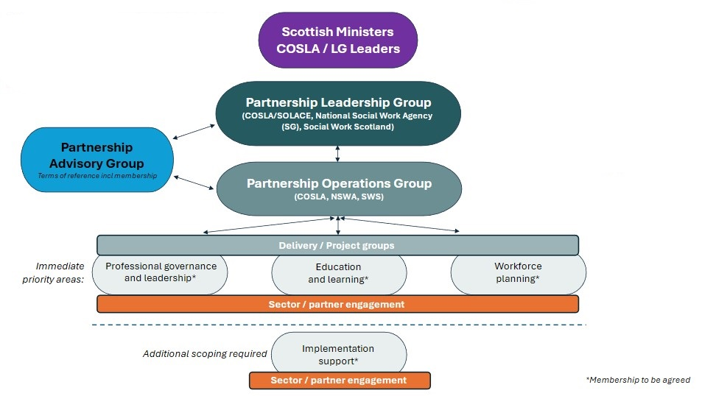
Scottish Social Work Partnership
Consensus based partnership approach underpinned by a memorandum of understanding

