Slide 1

The Disabled People’s Movement
Leading and Teaching
Heather Fisken
Inclusionscotland.org

Slide 2



Notes:
Please describe images

Slide 3





Notes:
Please describe images

Slide 4

Notes:
Please describe images

Slide 5

Notes:
Please describe images

Slide 6

For illustrative purposes only -
Notes:
Please describe images

Slide 7

Notes:
Please describe images

Slide 8
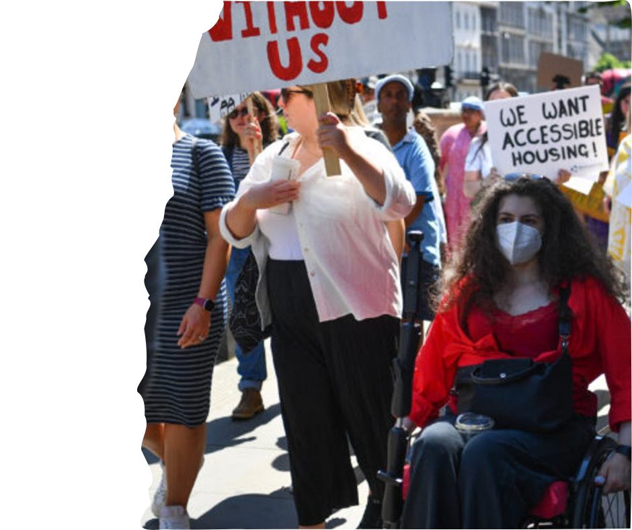
Notes:
Please describe images

Slide 9
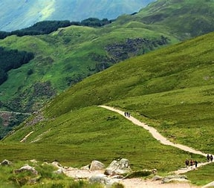
Notes:
Please describe images

Slide 10
Communication
support
Social Care Support / Personal
Assistance (SDS)
Social & civic
participation
Access to the built Environment & Public Realm
Inclusive education & lifelong learning
Legal Rights & access to justice
Advocacy incl. independent, peer & collective
Accessible housing
Adequate Income through Fair Work
and/or benefits
Accessible transport
Peer support: communities of identity & belonging
Accessible & inclusive healthcare
Technical aids & equipment
Information - in accessible formats
Employment
Notes:
Please describe images

Slide 11
Independent living
Choice – not permission from others
Control – not constraint by others
Dignity – not dread
Freedom – not driven by finance
Notes:
Please describe images

Slide 12

Telephone: 0131 370 6700 info@inclusionscotland.org inclusionscotland.org

